Slide 1
Lecture #5
Data collection (2/2): Web scrapping

Slide 2
Introduction
Most common method
3 methods :
Human method
API
Scrapping

Slide 3
Reminder
Like any other web data, be aware of copyrights, trademarks, intellectual properties, …
Consult the law, the website owner, … according to your objective (publishing data, …)

Slide 4
Scrapping
Web scraping is the process of using bots to extract content and data from a website.
Libraries depend on the wanted information and the website (html, image, XML, …)
Same library can be used to test your website

Slide 5
3 types of scrapping
Just scrap one specific page: a simple xml or html parser
Allowed human interaction: Browser based robot
Whole scrapping without human interaction: a spyder robot

Slide 6
Understanding of a webpage
“Inspect” the page
2 main tools:
Request tool called Network
Inspection tool for the html code and markups

Slide 7
The network tool
Explore page loadings in which order
Allow to see files, type of files, time for loadings, information about files, …
Copying request with “requests” library

Slide 8
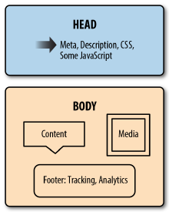
Scrapping text: the Html file
2 components: head and body
Containers (like XML files)
“Inspect” the page to see it
Example: The KBTU website

Slide 9
The html tool
The markups help you to find info (<img> markup for example)
Tags relation: Parents and children
The html tool shows the links between page and html markup

Slide 10
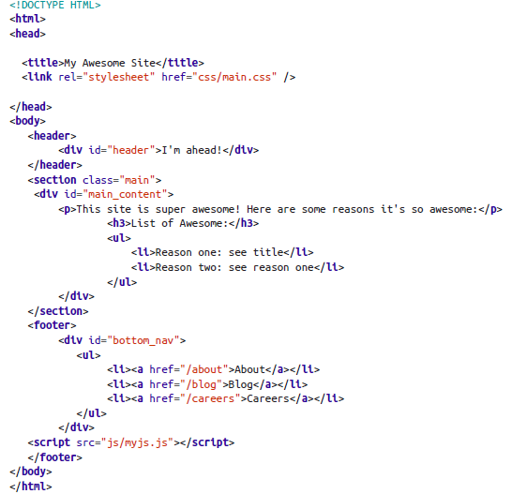

Slide 11
Begin the scrapping
“urllib” or “requests” libraries
Getting a html file is easy
Extracting information from it is harder

Slide 12
Continue the scrapping
“BeautifulSoup” library to accelerate scrapping:
pip install beautifulsoup4
from bs4 import BeautifulSoup
Extract markups, descendants of a markup, …
Be careful of website updates !

Slide 13
Browser-based scrapping
When data is not available in the HTML
When interaction is required (button, search, …)
Can be also used to script routine web tasks
Use the “Selenium” library

Slide 14
Selenium
Easier with firefox
Really depends on some computer settings

